Slide 1
Scheduling Criteria
Course Instructor
Anam Akbar

Slide 2
Scheduling Criteria
The goal of a scheduling algorithm is to identify the process whose selection will result in the best possible system performance .
Best performance is the subjective evaluation that comprises a mix of a number of criteria of varying relative importance.
The scheduling process determines the importance of each of the criteria.

Slide 3
Scheduling Criteria
Objectives of Process Scheduling Algorithm
Max CPU utilization [Keep CPU as busy as possible]
Fair allocation of CPU.
Max throughput [Number of processes that complete their execution per time unit]
Min turnaround time [Time taken by a process to finish execution]
Min waiting time [Time a process waits in ready queue] Min response time [Time when a process produces first response]

Slide 4
Scheduling Criteria
Some commonly used scheduling criteria are:
CPU Utilization
Balanced Utilization
Throughput
Turnaround Time
Wait Time
Response Time
Predictability
Fairness
Priorities.

Slide 5
Scheduling Algorithm
In early days of computing , scheduling was mostly non-preemptive; a process retained control of the CPU until the process blocked or terminated.(adequately served the needs of batch jobs)
On today’s interactive systems, Preemptive scheduling is used.
Scheduler may preempt a process before it blocks or terminates, in order to allocate the CPU to another process.
This is necessary on an interactive system, where lengthy execution without I/O by a process could monopolize the CPU, giving the process in the ready queue no opportunity to respond to their users

Slide 6
Scheduling Algorithm
Preemptive Scheduling
CPU scheduling decisions take place under one of four conditions:
When a process switches from the running state to the waiting state, such as for an I/O request or invocation of the wait( ) system call.
When a process switches from the running state to the ready state, for example in response to an interrupt.
When a process switches from the waiting state to the ready state, say at completion of I/O or a return from wait( ).
When a process terminates.
For conditions 1 and 4 there is no choice - A new process must be selected.

Slide 7
Scheduling Algorithm
For conditions 2 and 3 there is a choice - To either continue running the current process, or select a different one.
If scheduling takes place only under conditions 1 and 4, the system is said to be non-preemptive, or cooperative. Under these conditions, once a process starts running it keeps running, until it either voluntarily blocks or until it finishes. Otherwise the system is said to be preemptive.
Windows used non-preemptive scheduling up to Windows 3.x, and started using pre-emptive scheduling with Win95. Macs used non-preemptive prior to OSX, and pre-emptive since then. Note that pre-emptive scheduling is only possible on hardware that supports a timer interrupt.

Slide 8
Scheduling Algorithm
Note that pre-emptive scheduling can cause problems when two processes share data, because one process may get interrupted in the middle of updating shared data structures.
Preemption can also be a problem if the kernel is busy implementing a system call ( e.g. updating critical kernel data structures ) when the preemption occurs. Most modern UNIXes deal with this problem by making the process wait until the system call has either completed or blocked before allowing the preemption Unfortunately this solution is problematic for real-time systems, as real-time response can no longer be guaranteed.
Some critical sections of code protect themselves from concurrency problems by disabling interrupts before entering the critical section and re-enabling interrupts on exiting the section. Needless to say, this should only be done in rare situations, and only on very short pieces of code that will finish quickly, ( usually just a few machine instructions. )

Slide 9
Scheduling Algorithm
The duration for which a process gets control of the CPU and I/O is the CPU and I/O burst time, and the concept of gaining control of the CPU and I/O is the CPU burst and I/O burst.

Slide 10
Scheduling Algorithm
Arrival Time: Time at which the process arrives in the ready queue.
Completion Time: Time at which process completes its execution.
Burst Time: Time required by a process for CPU execution.
Turn Around Time: Time Difference between completion time and arrival time.
Turn Around Time = Completion Time - Arrival Time
Waiting Time(W.T): Time Difference between turn around time and burst time.
Waiting Time = Turn Around Time - Burst Time

Slide 11
Scheduling Algorithm
The most commonly used Scheduling Algorithms are:
First- Come First-Served
Shortest Job First
Shortest Remaining Time
Round Robin
Priority
Multi-Level FeedBack Queues

Slide 12
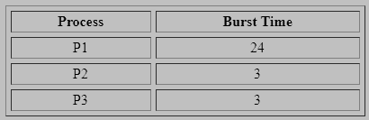
Scheduling Algorithm
First- Come First-Served
The Simplest Scheduling Algorithm.
Jobs are scheduled in the order they are received
Non- preemptive
FCFS can yield some very long average wait times
Consider an example

Slide 13
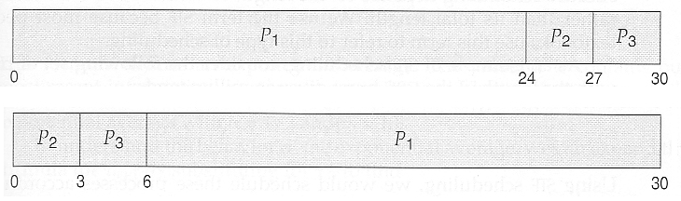
Scheduling Algorithm
First- Come First-Served
Case#01
process P1 arrives first. The average waiting time for the three processes is
( 0 + 24 + 27 ) / 3 = 17.0 ms
Case#02
The same three processes have an average wait time of ( 0 + 3 + 6 ) / 3 = 3.0 ms. The total run time for the three bursts is the same, but in the second case two of the three finish much quicker, and the other process is only delayed by a short amount.

Slide 14
Scheduling Algorithm
First- Come First-Served
FCFS can also block the system in a busy dynamic system in another way, known as the convoy effect.
When one CPU intensive process blocks the CPU, a number of I/O intensive processes can get backed up behind it, leaving the I/O devices idle. When the CPU hog finally relinquishes the CPU, then the I/O processes pass through the CPU quickly, leaving the CPU idle while everyone queues up for I/O, and then the cycle repeats itself when the CPU intensive process gets back to the ready queue.

Slide 15
Scheduling Algorithm
Shortest- Job First
Also known as shortest job next.
This is a non-preemptive scheduling algorithm.
Best approach to minimize waiting time.
Easy to implement in Batch systems where required CPU time is known in advance.
Impossible to implement in interactive systems where the required CPU time is not known.
The processer should know in advance how much time a process will take.

Slide 16
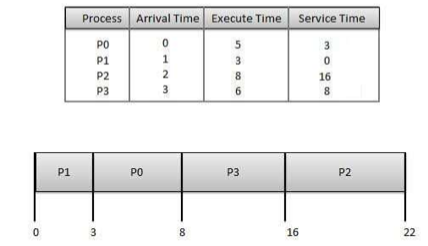
Scheduling Algorithm

Slide 17
Scheduling Algorithm
Wait time of each process is as follows:
Process Wait Time : Service Time - Arrival Time
P0 3 - 0 = 3
P1 0 - 0 = 0
P2 16 - 2 = 14
P3 8 - 3 = 5
Average Wait Time: (3+0+14+5) / 4 = 5.50

Slide 18
Scheduling Algorithm
Priority Based Scheduling
Priority scheduling is a non-preemptive algorithm and one of the most common scheduling algorithms in batch systems.
Each process is assigned a priority. Process with highest priority is to be executed first and so on.
Processes with same priority are executed on first come first served basis.
Priority can be decided based on memory requirements, time requirements or any other resource requirement.

Slide 19
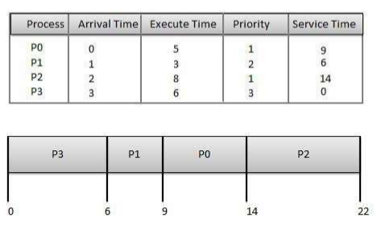
Scheduling Algorithm

Slide 20
Scheduling Algorithm
Wait time of each process is as follows:
Process Wait Time : Service Time - Arrival Time
P0 9 - 0 = 9
P1 6 - 1 = 5
P2 14 - 2 = 12
P3 0 - 0 = 0
Average Wait Time: (9+5+12+0) / 4 = 6.5

Slide 21
Scheduling Algorithm
Shortest Remaining Time
Shortest remaining time (SRT) is the preemptive version of the SJN algorithm.
The processor is allocated to the job closest to completion but it can be preempted by a newer ready job with shorter time to completion.
Impossible to implement in interactive systems where required CPU time is not known.
It is often used in batch environments where short jobs need to be given preference.

Slide 22
Scheduling Algorithm
Round Robin Scheduling
Round Robin is a preemptive process scheduling algorithm.
Each process is provided a fix time to execute; it is called a quantum.
Once a process is executed for a given time period, it is preempted and other process executes for a given time period.
Context switching is used to save states of preempted processes.

Slide 23
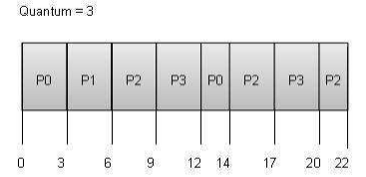
Scheduling Algorithm

Slide 24
Scheduling Algorithm
Wait time of each process is as follows:
Process Wait Time : Service Time - Arrival Time
P0 (0-0) + (12-3) = 9
P1 (3-1) = 2
P2 (6-2) + (14-9) + (20-17) = 12
P3 (9-3) + (17-12) = 11
Average Wait Time: (9+2+12+11) / 4 = 8.5

Slide 25
Scheduling Algorithm
Multiple-Level Queues Scheduling
Multiple-level queues are not an independent scheduling algorithm. They make use of other existing algorithms to group and schedule jobs with common characteristics.
Multiple queues are maintained for processes with common characteristics.
Each queue can have its own scheduling algorithms.
Priorities are assigned to each queue.
For example, CPU-bound jobs can be scheduled in one queue and all I/O-bound jobs in another queue. The Process Scheduler then alternately selects jobs from each queue and assigns them to the CPU based on the algorithm assigned to the queue.

